Slide 1

Robot Movement Automation with Computer Vision
BY
USN Name
1CR16EC004 Adarsh U
1CR16EC024 B Karthik
1CR16EC033 Dabir Hasan Rizvi
1CR16EC037 Deepak Kamath K
Under the Guidance of Dr.R Elumalai
Electronics and Communication Department
Date-23-05-2020

Slide 2
ABSTRACT
In recent times, we have seen an immense increase in the amount of research,development and investment put in the field of Autonomous Vehicle Technology or in common terms - Self-Driving Vehicles.
This project demonstrates the use of digital image processing and computer vision to enable a robot to track specific objects in an environment and follow them.
Electronics and Communication Department

Slide 3
INTRODUCTION
An autonomous vehicle is capable of sensing its environment and operating without human involvement. Autonomous vehicles rely on sensors, actuators, complex algorithms, and powerful processors to execute software.
Studies show that around 90% of all vehicular accidents are caused by human error leading to a huge number of unnecessary deaths worldwide.
Computer Vision is a field of digital image processing that focuses on replicating parts of the complexity of the human vision system and enabling computers to identify and process objects in images and videos in the same way that humans do using image information from cameras and other devices. With the help of the sensors they get information from the surroundings to enable self driving.
Electronics and Communication Department

Slide 4
INTRODUCTION
The aim of the Project is to use necessary hardware and software with the power of Digital Image Processing to implement a Self Driving robot.
We use object feature tracking image processing algorithms, use of modern technologies like Augmented Reality in the user-interface and IoT based communication to make a Self Driving Robot.
Electronics and Communication Department

Slide 5
OBJECTIVE
The basic objective of this project is to develop a robot that efficiently follows any object(image) as selected by the user in an environment as long as the robot and the object are in the range of the same network connection(Wi-Fi).
The system proposed must be able to quickly identify feature points of the selected object that the robot has to follow.
Besides identifying feature points, the robot has to be able to follow the object even if the objects orientation and scale changes.
Electronics and Communication Department

Slide 6
MOTIVATION
An environment such as a warehouse or a factory consists of a lots of tasks that involve humans driving industry specific vehicles inside the environment such as forklifts, hand trucks, order pickers etc.
At times humans have to risk themselves as they might have to work in hazardous environments.
By Eliminating the requirement of a driver also brings about comfort if the same work can be done remotely by passing on the task to an autonomous vehicle.
Electronics and Communication Department

Slide 7
LITERATURE REVIEW
A brief history of Autonomous Vehicles
A paper by the name “Algorithms applied in Autonomous Vehicle Systems” [1] discusses the development paths and key algorithms of autonomous vehicles.
The first autonomous vehicle concept was realized in 1995 when a vehicle was able to move for about a 1000 km without human assistance. Fast-forwarding to the 21st century, Tesla launched a not fully autonomous car in the year 2014. Research is still on with a intense competition from several manufacturers such as Ford.
Electronics and Communication Department

Slide 8
LITERATURE REVIEW
Previous work - Line Following Robot Using Image Processing
This is an example of an implemented digital image processing based robot and some algorithms currently in use for image analysis, path planning, information storage and decision systems.
In the paper "Line Following Robot Using Image Processing" [2], a robot was developed that was able to follow a line detected by a camera mounted on it.
A camera is used to obtain image of the track and then converted into a bitmap image. Least Square Method is used to follow the predefined path. Turns were calculated using the slopes of the line captured within the scope of the camera. Thus, by using image processing the line following robot is guided along the desired path.
Electronics and Communication Department

Slide 9
LITERATURE REVIEW
Examples of techniques used in Autonmous Vehicles
Some examples of sensor based image processing algorithms are - Vanishing Point method for finding a road in the desert which consists of calculating dominant orientations in image segments and estimating the position of point of convergence between two parallel lines because two parallel lines that form a lane(road) meet at one point in a 2D image captured by a camera, modern methods of analysis using Machine Learning to detect and classify objects captured by a camera, RADAR based estimation of speed, orientation and range of objects.
Specifically talking about path finding, algorithms such as A* and Djikstra’s algorithm have been used by autonomous vehicles to find paths based on travel time, distance and fuel consumption.
Electronics and Communication Department

Slide 10
LITERATURE REVIEW
Autonomous Vehicles combine various techniques of perceiving the environment using sensors, analytical algorithms as well as AI or ML which generally produces better results. But replacing all image processing algorithms with ML does not seem to be too viable as it requires a lot of data and storage infrastructure. The choice of algorithms depend on computational power, type of sensor, quality of sensors and level of automation that the vehicle aims to achieve.
Several researchers have implemented object detection using algorithms known as Speeded-Up Robust Features(SURF) and Scale-Invariant Feature Transform(SIFT) which are specifically used to identify edges and features in an image. In this project, SIFT was used to serve our use case efficiently.
Electronics and Communication Department

Slide 11
METHODOLOGY
Work – Flow of the system -:
Enable the communication of the backend and Robot via IP address.
Image processed
for feature points
and saved as
a target image.
Robot listens for packets and turns motors ON/ OFF according to the position of the target image.
Movement of the robot within specified bounds.
Object selection and tracking with a GUI and Camera.
Computer Vision
Electronics and Communication Department

Slide 12
METHODOLOGY
The Robot can work in a closed or open environment.
Closed Environment (Target following) : Assembly lines,Warehouse are examples.Here the robot has to perform tasks such as picking and dropping parts.Here it has a target image which it has to follow.The robot has to be in range of the WiFi for it to function.
Open Environment (Target object approaching): Open roads is an example.Here there are many tasks that have to performed compared to closed environment.There are more parameters that have to be taken into account like road signs,people,obstructions etc.
Electronics and Communication Department

Slide 13
METHODOLOGY
1.Image Tracking
The image has to be tracked and doing so takes time,during this time there might be a change in the orientation of the image to still capture the image we use SIFT(Scale-Invariant Feature Transform).
2.Implementation of SIFT
We decide on an image and take the feature points of the images,then the image is rotated,shifted tilted so that even if there are any changes made to the image it is detected.

Slide 14
SIFT - Scale Invariant Features Transform
SIFT is a computer vision based feature detection algorithm used to detect and describe local features in images.
SIFT consists of 5 important steps of implementation:
Scale - space extrema detection
Keypoint Localization
Orientation Assignment
Keypoint Descriptor
Keypoint Matching

Slide 15
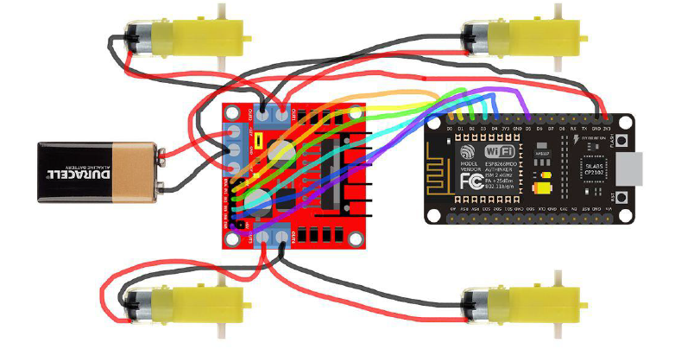
HARDWARE
The hardware parts used and their specifications are:
1.Robot Chassis with mounting holes for modules, wheels, connecting wires and battery holder.
2.L298N Motor Driver Module.
3.WiFi Module-ESP8266 Node MCU.
4.DC Motors for wheels.
5.12 V Rechargeable Battery
Fig: Hardware Connections of the robot
Electronics and Communication Department

Slide 16
SOFTWARE
The software libraries and development kits used are:
1. OpenCV- This library has dedicated functions and modules to implement several image
processing algorithms including the SIFT algorithm.
2. Unity 3D with Vuforia SDK - Vuforia is an Augmented Reality(AR) SDK used to build AR applications. Since this project involves image feature detection similar to AR, Vuforia SDK with Unity3D was used to build the user interface application.
3. Arduino IDE- We use the Arduino platform to enable the communication between the robot and the motors.
Electronics and Communication Department

Slide 17
RESULTS AND DISCUSSION
The main aim was to come up with a solution for an autonomous vehicle to move freely without any interactions from humans.
Using necessary software and hardware the robot moves according to the
target image used, the robot detects the image as it is Scale invariant
and Orientation invariant.
The robot was able to successfully detect the book as it was the target
image and follow the book,as the battery levels dropped the sensitivity dropped.
Electronics and Communication Department

Slide 18
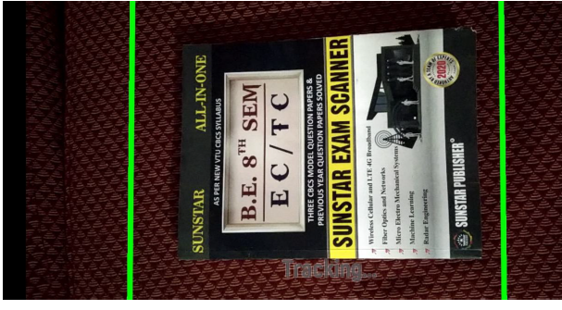
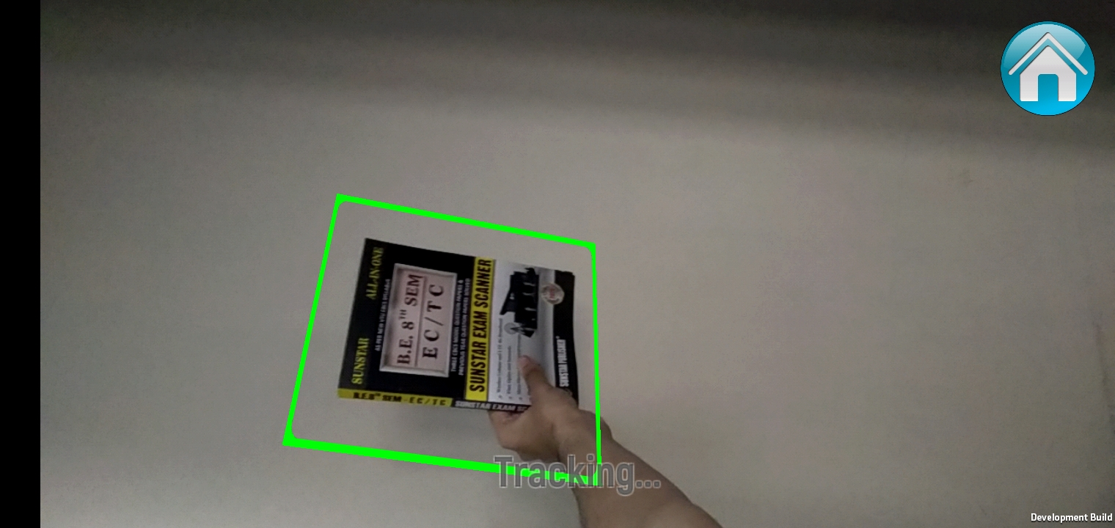
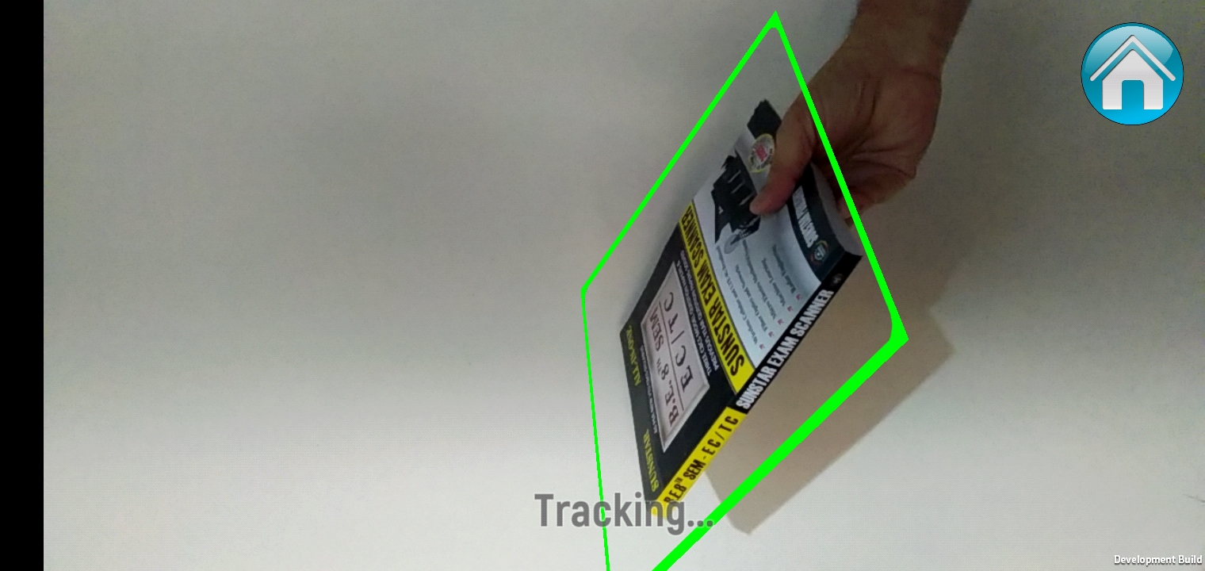
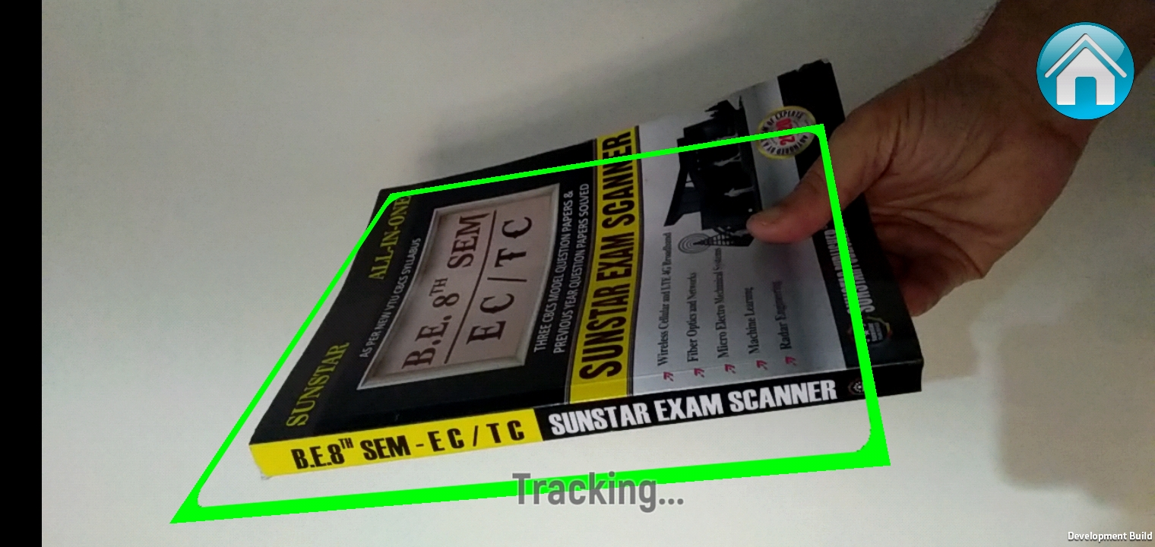

Slide 19
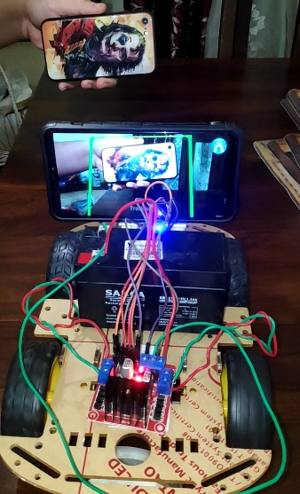
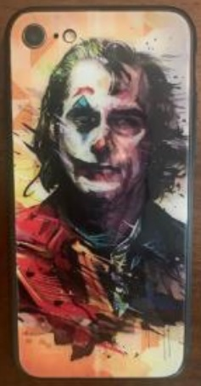
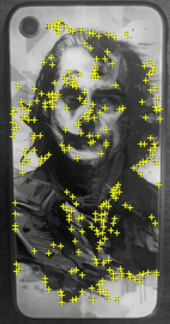
The complete solution
The target object that we used
Feature points detected on it

Slide 20
LIMITATIONS
Some limitations of this project are:
Not all object images can yield good results and good target images must be images with good contrast, a lot of details and good environmental lighting. The problem of poor lightning can be solved using illumination techniques based on digital image processing and the same goes with improving contrast and details with techniques such as contrast histogram flattening, image sharpening etc.
Another drawback of this implementation is the fact that robot will stop moving if the camera is blocked or is no longer in the scope of the object due to any disturbance in the environment or a technical error in the camera. This can be solved by saving the approximate location of the object based on signal strength but this only works in the case of static objects.
Similarly if the robot is blocked by an obstacle, it must be able to take a turn as required to avoid collision using ultra sonic sensors for instance or image processing itself.
Electronics and Communication Department

Slide 21
CONCLUSION
As per the aim of this project, we were able to identify two applications of image following robots- Industrial robots and Autonomous Cars. Several methodologies were identified to go ahead with this project and we chose to the use a very efficient feature extraction algorithm known as SIFT.
A lot of keypoints were identified in very less time and the robot was able to follow them even when the object was rotated and scaled up or down.
Electronics and Communication Department

Slide 22
FUTURE WORK
As discussed in the limitations section, some of the limitations are obstacle detection and decision making under such cases. These are the short term goals that have been planned as the next step to improve the functionality of this project.
While only two applications and use cases were described in detail in this report, the very same technology can be used in military applications such as guiding a missile to follow an object ,usage of spy devices designed to follow people or objects,etc.
This project has a lot of potential and scope to display better results owing to improved research in this field and greater computation capabilities of modern world technologies such as Computer Vision, Machine Learning, IoT etc.
Electronics and Communication Department

Slide 23
REFERENCES
[1] Bugała, Michał. (2018). Algorithms applied in Autonomous Vehicle Systems.
[2] J. Sarwade, S. Shetty, A. Bhavsar, M. Mergu and A. Talekar, "Line Following Robot Using Image Processing," 2019 3rd International Conference on Computing Methodologies and Communication (ICCMC), Erode, India, 2019, pp. 1174-1179, doi: 10.1109/ICCMC.2019.8819826.
[3] Lindeberg, Tony. (1994). Scale-Space Theory: A Basic Tool for Analysing Structures at Different Scales. Journal of Applied Statistics. 21. 224-270. 10.1080/757582976.
[4] Lowe, David. (2004). Distinctive Image Features from Scale-Invariant Keypoints. International Journal of Computer Vision. 60. 91-. 10.1023/B:VISI.0000029664.99615.94.
Electronics and Communication Department

